Slide 1
ENGR 181 W Developing a Presentation
https://www.gcflearnfree.org/powerpoint-tips/simple-rules-for-better-powerpoint-presentations/1/
http://www.ncsl.org/legislators-staff/legislative-staff/legislative-staff-coordinating-committee/tips-for-making-effective-powerpoint-presentations.aspx
https://www.cs.cmu.edu/~mihaib/presentation-rules.html
https://www.comm.pitt.edu/oral-comm-lab/audience-analysis
https://business.tutsplus.com/tutorials/how-to-make-your-powerpoint-presentation-design-better--cms-28172
https://www.interaction-design.org/literature/article/the-building-blocks-of-visual-design

Slide 2
PREPARING THE PRESENTATION
Developing a worthwhile presentation is like developing a product: Research and planning are crucial in the early stages.
First: Analyze Your Audience

Slide 3
Some Questions to Ask About Your Listeners Before You Talk
• Who will the key individuals in my audience be?
• What needs or concerns do they have regarding my topic?
• What are my objectives for this talk?
• How knowledgeable are my listeners about my subject?
• How can I get their attention and interest right away—and keep it?
• What are their attitudes likely to be regarding what I have to say?

Slide 4
Some Questions to Ask About Your Listeners Before You Talk
• Do I need to work on changing their attitudes, and if so, what is the best way to go about it?
• What benefits are they going to get from listening to me?
• What kind of questions are they likely to ask?
• What kind of feedback do I want?

Slide 5
About the Audience
•Audience Analysis
Overview
• Audience analysis and taking an audience-centered approach
• Identifying the audience and adapting a speech to their interests
• Level of understanding, attitudes, and beliefs of the audience

Slide 6
About the Audience
•Audience Analysis Factors
Audience expectations
• Expectations about the occasion, topic, and speaker.
Example: when the speaker is an electrical engineer, and the topic is the future of electric power
▪ Expectation?
▪ Exception?
Audience knowledge of a topic
• Never overestimate or underestimate the audience’s knowledge of a topic.

Slide 7
Attitude toward topic
Audience size
Demographics: Age, gender, religion, ethnic background, class, sexual orientation, occupation, education, group membership, etc.
Setting: The set-up of the room (both size and how the audience is arranged), time of day, temperature, external noises, internal noises, and type of space (church, schoolroom, outside).
Voluntariness: Audiences are either voluntary or involuntary, in which case they are not inherently interested in the presentation.
Egocentrism: is the inability to differentiate between self and other

Slide 8
Determine Your Time Frame
It has been said that no speech is ever too long for the speaker or too short for the listener.
The cardinal rule here is never to speak longer than you are supposed to.

Slide 9
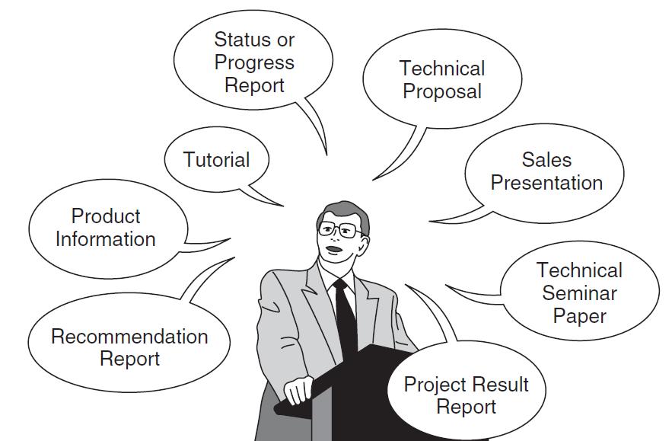
Just a few of the many kinds of presentations engineers find themselves giving.

Slide 10
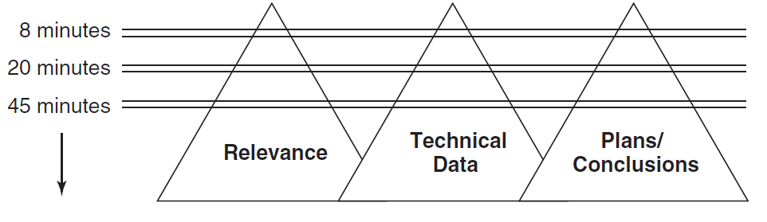
This diagram illustrates, how deeply you go into different aspects of a typical engineering topic is related to how much time you have to speak.

Slide 11
How to Start?
Introduce yourself?
Checking the audio/video? Asking about time…
A question that matters to audience?
A shocking Fact?
What connects you (or the audience) to this topic?

Slide 12
How to Start?
Professional / Academic
How to Introduce yourself
- Name and affiliation
- Your specialty/ Value/ Production
- The reason for your presentation/ Importance
Public / Diverse Audience
- Your Hook, WOW story
- Transition Topic
- Self- Introduction
- Audience Benefit
Types of Presentation
Visual Style
Freeform Style
Instructor Style
Coach Style
Storytelling Style
Connector Style

Slide 13

https://youtu.be/Rp9PfqUQ8a4

Slide 14

https://www.youtube.com/watch?v=Gj8IA6xOpSk

Slide 15
Identify Your Key Points
Oral presentations don’t permit us to give all the miniscule details about every aspect of our topic.
Define your main purpose and based on the time frame, develop the presentation based on important points.

Slide 16
Identify Your Key Points
Each Slide works like a Paragraph in an essay: it should cover only one subject.
You can depict main concepts of the subject by bullet point lines.

Slide 17
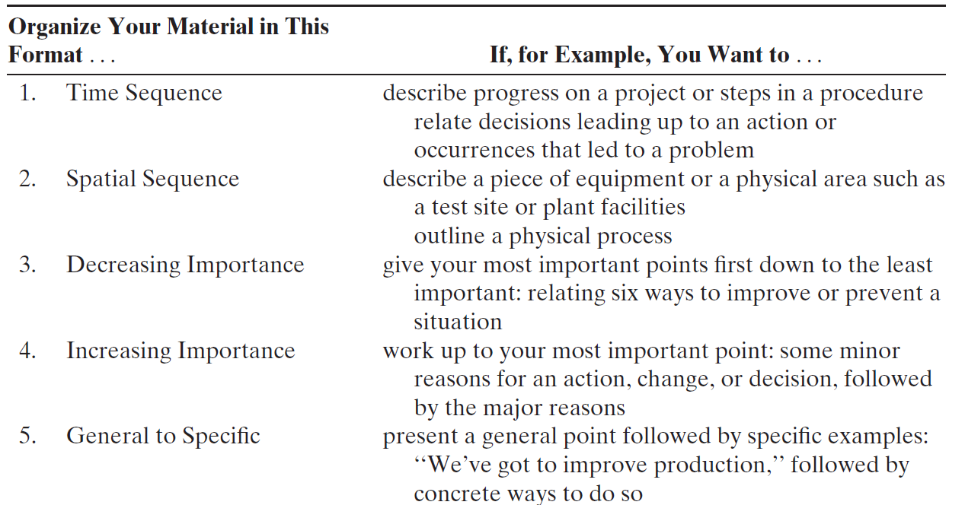
Prepare an Outline and Notes

Slide 18
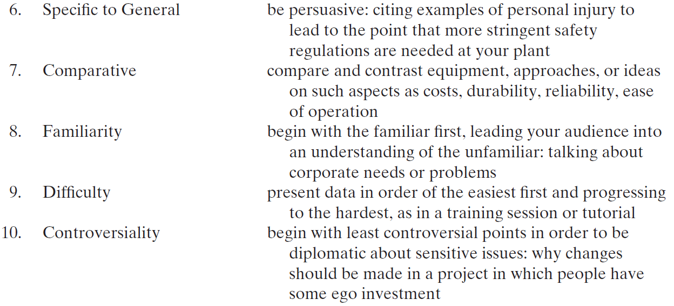

Slide 19
Prepare an Outline and Notes
Reading a word-for-word written version of your talk in front of an actual audience is NOT a good idea.
Determine which prompts will best keep you on track when giving it.

Slide 20
Create Supporting Graphics
Most effective engineering speakers support their talks with illustrations of some kind.
You should use visuals wherever you feel they will
simplify a point
clarify a point
stress a point
show critical relationships between ideas or facts
In tests, people generally remember about 10% of oral information three days later, but that number jumps to 65% if a relevant image is added.

Slide 21
Make Your Information Accessible
Too complex: Don’t let your visuals suffer from information overload.
Too small: If your visuals consist of lists or other written information, make the words easy to read

Slide 22
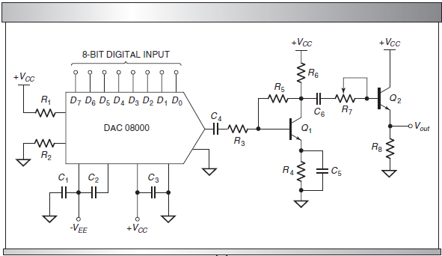
Make Your Information Accessible
Too complex:

Slide 23
Make Your Information Accessible
Simplified block diagram of the circuit in previous slide:

Slide 24
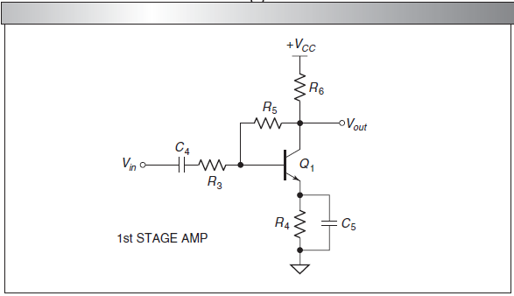
Make Your Information Accessible
The center block from the diagram expanded to show part of the original circuit.

Slide 25
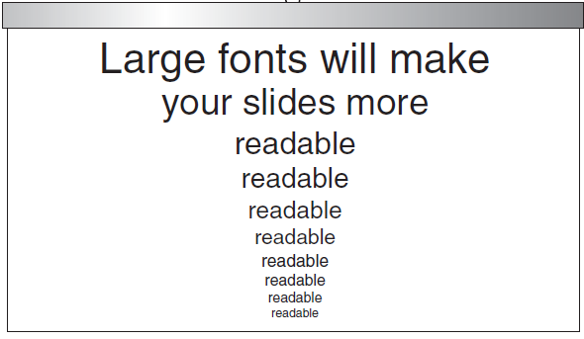
Make Your Information Accessible
Use at least 24-point print on your overheads if you want your audience to read them.

Slide 26
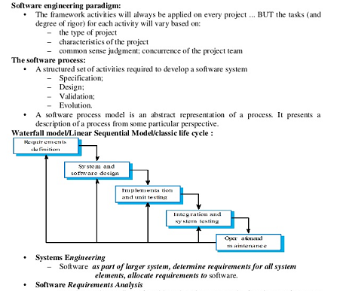
Prepare Handouts
Think carefully about whether you want to provide handouts, and if so, what kind and when you will hand them out.

Slide 27
Prepare Your Introduction
When thinking of how to begin your talk, remember that
1. Your audience may be asking themselves, at least subconsciously, ‘‘Why do I need to hear this?’’
2. Your audience has a limited attention span.

Slide 28
Prepare Your Introduction
To help solve both problems, design your introduction to let your audience know right away what your topic is and of what benefit it is to them.
In essence, tell them why they should listen to you.
Let your audience know how long you intend to speak if it’s not already known.

Slide 29
How to End? Prepare Your Conclusion
Design the end of your presentation to focus the audience’s attention solely on essentials.
• Summarize what you have discussed
• Stress your central idea once more
• Review your key points
• Restate your recommendations or decisions

Slide 30
How to End? Prepare Your Conclusion
The Audience usually remembers:
Introduction
Conclusion

Slide 31
Get Ready for Questions
Take note
Answer briefly but accurately
If you don’t know the answer, be honest
Think of diplomatic ways to encourage questions from people who are reluctant to ask

Slide 32
Avoiding Noise in Engineering Presentations
Typical noises:
1. Speaking Too Softly
2. Speaking Too Slowly or Rapidly
3. Speaking Monotonously: Show ENTHUSIASM
4. Using Verbal Fillers: uh, umm, basically, yu’no
5. Becoming a Statue, Pendulum, or Traveler
6. Blocking the Screen
7. Reading from the screen or from notes

Slide 33
Strengthening Your Presentations
Use an Informal Style
Make Clear Transitions.
Keep your listeners in the picture by emphasizing connections and transitions in your thinking by using simple words and phrases like these:
First, Next , On the other hand, As you can see
Repeat Key Points
Use a Pointer
Maintain Eye Contact

Slide 34
Eight Simple Rules for Making Good Oral Presentations
Rule 1: Talk to the Audience
Understand your audience’s background and expectations. Tailor your content to what they need and want to learn.
Rule 2: Less Is More
Avoid overloading your presentation with too much information. Focus on a few clear, important ideas.

Slide 35
Eight Simple Rules for Making Good Oral Presentations
Rule 3: Only Talk When You Have Something to Say
Present meaningful, relevant content only. Respect the audience’s time by avoiding unnecessary material.
Rule 4: Make the Take-Home Message Persistent
Ensure your key points are memorable. Emphasize a few main ideas the audience will retain.

Slide 36
Eight Simple Rules for Making Good Oral Presentations
Rule 3: Only Talk When You Have Something to Say
Present meaningful, relevant content only. Respect the audience’s time by avoiding unnecessary material.
Rule 4: Make the Take-Home Message Persistent
Ensure your key points are memorable. Emphasize a few main ideas the audience will retain.

Slide 37
Eight Simple Rules for Making Good Oral Presentations
Rule 5: Be Logical
Structure your presentation like a clear story. Maintain a logical flow from beginning to end.
Rule 6: Treat the Floor as a Stage
Engage the audience without overacting. Be natural and confident in your delivery.

Slide 38
Eight Simple Rules for Making Good Oral Presentations
Rule 7: Practice and Time Your Presentation
Rehearse to improve clarity and timing. Stay within limits and avoid unnecessary deviations.
Rule 8: Use Visuals Sparingly but Effectively
Use visuals to support, not overwhelm your message. Ensure visuals are clear, relevant, and purposeful.

Slide 39
Strengthening Your Presentations
Be Ready for Unexpected Questions
Two strategies for tackling unexpected questions are to:
1. Simply say you don’t know
2. Offer to talk with the questioner after your presentation
Are you nervous?
Be at the presentation place earlier
Try to have a few friends/colleagues in the audience to give you moral support

Slide 40
General Rules
Don't read your presentation straight from the slides
Follow the 5/5/5 (or 7/7/7) rule
No more than five words per line of text, five lines of text per slide, or five text-heavy slides in a row.
Don't forget your audience
Choose readable colors and fonts
Don't overload your presentation with animations

Slide 41
General Rules
Use a Maximum of 15 Slides (though it depends to the topic and your slide design)
For a talk of less than 10 minutes, 5 or 6 slides are enough
Make Your Titles Headlines, Not Descriptions
Let the Titles Tell the Story
Layout Counts
Give Your Audience a Roadmap
Vary Your Format
Always Close With an Ask

Slide 42
General Rules
Limit punctuation and avoid putting words in all capital letters.
Empty space on the slide will enhance readability.
Use contrasting colors for text and background.
Avoid the use of flashy transitions such as text fly-ins.
Use good quality images that reinforce and complement your message.
Have a Plan B in the event of technical difficulties.
Do not apologize for anything in your presentation.

Slide 43
General Rules
Use only one idea per slide
Have a good conclusions slide
Having periodic "talk outline" slides (to show where you are in the talk) especially for longer talks
Don't count on the audience to remember any detail from one slide to another
Try to cut out as much as possible; less is better
Humor is very useful

Slide 44
General Rules
1. Visual Hierarchy. Understanding the basics of visual hierarchy and how you can use it effectively in a presentation.
2. Slide Layout. Turning the design principles of visual hierarchy into effective PowerPoint slide designs.
3. Typography. Choosing the right typefaces.
4. Color. The basics of color theory.
5. Details. The extras that make your presentation great.

Slide 45
General Rules
How to make an effective PowerPoint
Visual Hierarchy.
Slide Layout.
Typography.
4. Color.
5. Details.

Slide 46

General Rules
Visual Hierarchy.
- Arrange elements in a way that it implies importance.
- Design elements with a stronger contrast than others.
https://business.tutsplus.com/tutorials/how-to-make-your-powerpoint-presentation-design-better--cms-28172

Slide 47
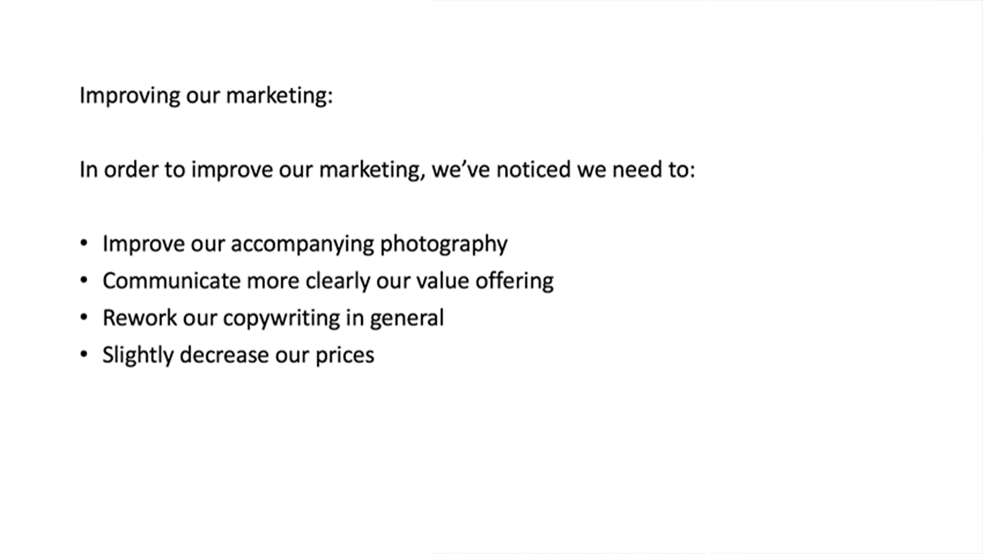

Visual Hierarchy

Slide 48
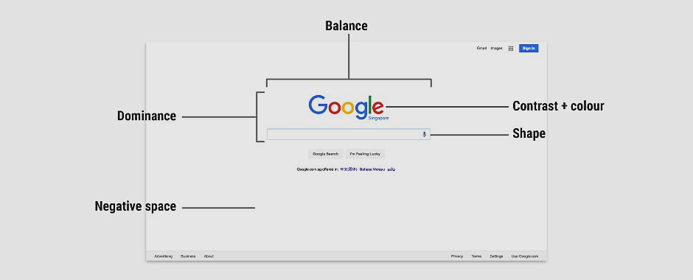
General Rules

Slide 49






Size impacts visibility
Perspective creates an illusion of depth
Color and contrast draw attention
Fonts organize design.
Space provides emphasis and movement
Negative space emphasizes.

Slide 50


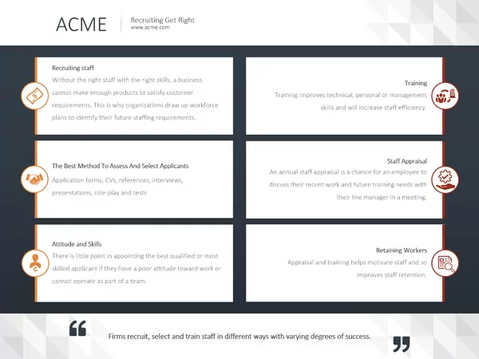
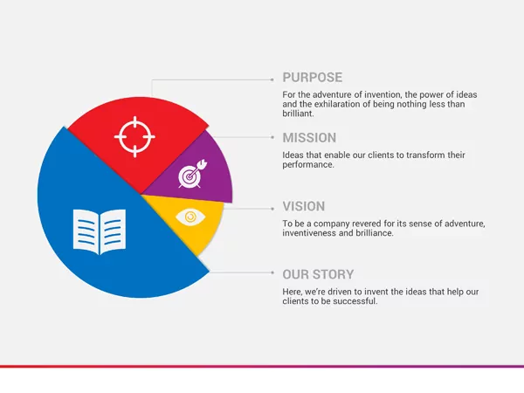
Slide Layout Design
Contrast, Grouping and Alignment

Slide 51




Typography
Stick to Standard Fonts:
Calibri
Gill Sans
Myriad Pro
Cambria
Corbel
Constantia
Garamond
Caslon
Georgia
Tahoma
Incorporate Contrast
Better to use Sans Serif
Avoid All Caps
Use Fonts Consistently
Avoid Italics (except the needed places)

Slide 52
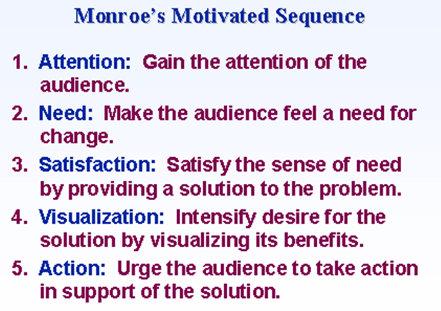

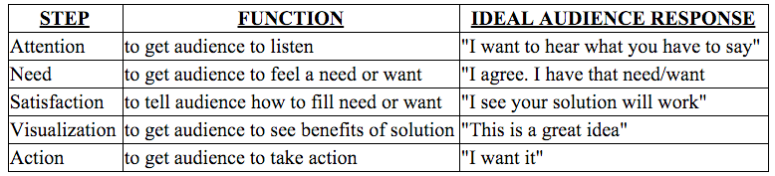
Developed by American psychologist Alan Monroe at Purdue University in the mid-1930s

Slide 53
Useful Tutorials
https://www.youtube.com/watch?v=dEDcc0aCjaA
https://www.youtube.com/watch?v=-w66TglPRbc
https://www.youtube.com/watch?v=Yl_FJAOcFgQ
https://www.youtube.com/watch?v=w82a1FT5o88

Slide 54
Effective PowerPoint Presentation Tips
https://business.tutsplus.com/articles/37-effective-powerpoint-presentation-tips--cms-25421
https://www.uis.edu/informationtechnologyservices/wp-content/uploads/sites/106/2013/04/PPDesignTips.pdf

Slide 55
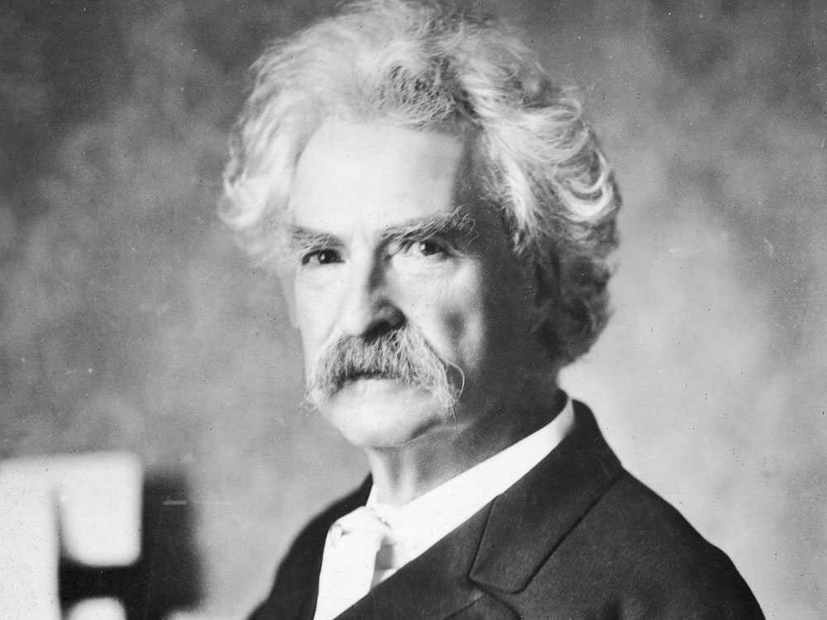
Manage Your Anxiety "There are two types of speakers. Those who get nervous and those who are liars." (Mark Twain)

Slide 56
- Focus on delivering your message, not on how you feel. - Smile. - Keep presenting! Your anxieties decrease the more presentations you give.)

Slide 57
Create a Strong Beginning Clearly identify the objectives at the beginning of the session

Slide 58
1. Know Your Stuff
Your presentation is about the message you want to get across.
Think about the narrative that will be discussed, why and in what order.

Slide 59
2. Write it Out
Make a script to show how the information presented will “flow”, and how viewers will see it in sequence.

Slide 60
3. Highlight What is Most Important
A presentation covers the most crucial pieces only.
Pick key points

Slide 61
4. Know Your Audience
Your topic selection,
The language you use,
The examples you give to illustrate points, … should be tailored specifically with your target audience in mind.

Slide 62
5. Keep Your Slides Simple
PowerPoint is not an alternative to a written, formal report.
The spoken word speaks to the audience’s left brain.
The slideshow speaks emotionally to the audience’s right brain!

Slide 63
6. Limit Words on Your Slides
The audience should be listening and watching the visuals, not reading.

Slide 64
7. Use High-Quality Photos and Graphics 8. Avoid Clip Arts. Avoid Flashy Slide Transitions 9. Use Accurate and Relevant Charts and Graphs

Slide 65
10. Choose Appropriate Fonts San-serif, such as Arial or Calibri (fonts with no “feet” like Feet) 11. Choose Color Well 12. Clean + Simple Formatting

Slide 66
13. Make Sure All Objects Are Aligned 14. Limit Punctuation 15. Avoid Over-Formatting Your Points

Slide 67

16. Practice With a Timer

Slide 68
17. Slow It Down You will have the chance to emphasize, appear more thoughtful, and make your information easier to digest. 18. Choose Three Focal Points in the Room

Slide 69
19. Eye contact Eye contact creates a great connection with your audience 20. The quality of your presentation is most directly related to the quality of your preparation. Believe in the importance of your message.

Slide 70
21. Conclude with a Strong Ending 22. Listen attentively before responding to questions. Better to take note . Believe in the importance of your message.

Slide 71

https://youtu.be/Iwpi1Lm6dFo

